Slide 1









Offline Downloading in China:
A Comparative Study
ACM SIGCOMM
ACM SIGMETRICS
Zhenhua Li
Christo Wilson
Tianyin Xu
Yao Liu
Zhen Lu
Yinlong Wang
lizhenhua1983@gmail.com
http://www.greenorbs.org/people/lzh/
Oct. 30, 2015
Notes:
Good afternoon, everyone! Now it’s my turn to tell the story of offline downloading in China by a comparative study.
I’m the 1st author Zhenhua Li, and the 2nd author Christo Wilson is also here.

Slide 2
Outline
1
Background
2
Problem
3
System
4
Workload
5
Performance
6
Optimization
Notes:
This is the outline of my presentation. First, let’s look at the background.

Slide 3
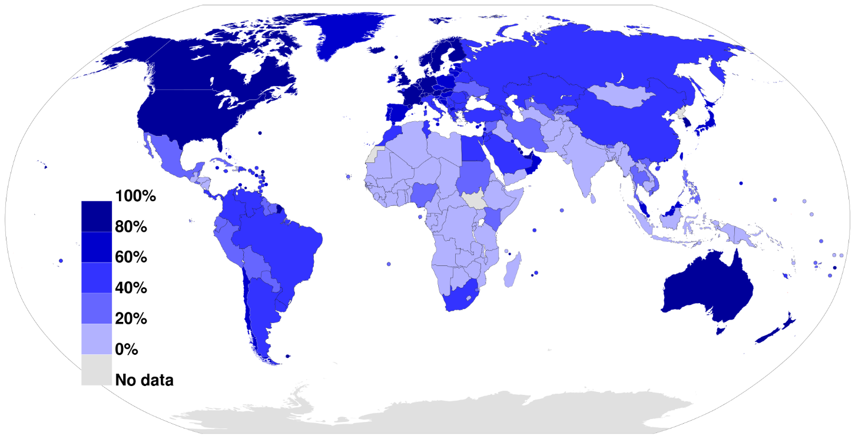


Internet Access across the World
Internet Penetration
Broadband: > 25 Mbps of Download Bandwidth
Broadband: ≈ 4–10 Mbps, Unstable and Limited
Not only penetration, but also quality of connections !
Notes:
Internet access across the world has become more ubiquitous in recent years.
However, the digital divide still exists between the developed world and the developing world.
Still worse, the digital divide lies in not only the penetration, but also the quality of network connections.
For example, in US the broadband access has been defined as higher than 25 Mbps in terms of download bandwidth, while in China, the broadband bandwidth usually lies between 4 and 10 Mbps, and it is quite unstable and limited.

Slide 4




Pains of the Developing World
Downloading large files requires high-quality network connections!
DTN - Delay
Tolerant Networking ?
Notes:
This digital divide prevents many users in developing countries from accessing the full wealth of today’s Internet, especially those large files (e.g., HD videos, large software, and big data) which require high-quality network connections to download!
Researchers have studied various approaches to making the Internet more accessible, performant, and affordable, such as DTN, delay-tolerant networking.
Nevertheless, to date these technologies have not been widely deployed or evaluated in practice.

Slide 5

The Case of Modern China
Promises
46% of China’s population has come online
World-class companies like Tencent, Baidu, Alibaba, and Sina Weibo (Microblog)
Notes:
Modern China exemplifies both the promise and challenges of increasing Internet penetration.
In the last ten years, 46% of China’s population has come online, and China is now home to world-class Internet companies like Tencent, Baidu, Alibaba, and Sina Weibo.

Slide 6
The Case of Modern China
Over 72% of China’s Internet users have low-quality network connections
Challenges
Low access bandwidth
Unstable/ unreliable connection
ISP barrier (Poor inter-connectivity between ISPs)
Other reasons
Notes:
However, the majority (over 72%) of China’s Internet users have low-quality connections,
due to low access bandwidth, unreliable/unstable data connection, ISP barrier, and other reasons.

Slide 7
“Offline Downloading” in China
An HTTP/FTP/
P2P link
Notes:
To deal with the problems caused by low-quality Internet connections, numerous China’s users have resorted to technologies that allow for “offline downloading” of large files.
Specifically, when a user wants to acquire a file, she first requests a proxy to pre-download the file on her behalf. The request is typically an HTTP/FTP/P2P link.
The proxy may have access to faster, cheaper, or more reliable connectivity, so it is better suited to downloading the file from the Internet.
The, the user can fetch the file from the proxy at a later point in time, when local network conditions are conducive to the task.
During the whole process, the user is free to be offline in most time --- this is why we call this technique as “offline downloading”.

Slide 8




Typical Implementation (1): Cloud-based
Caches PBs of files in a datacenter that is within or directly peered with the requesting user’s ISP
Tencent
Xuanfeng
Baidu
CloudDisk
Xunlei
Notes:
In this paper, we examine two typical implementations of offline downloading that are extremely popular in China.
First is the cloud-based approach that leverages a geo-distributed, massive cloud storage pool as the proxy.
It usually caches petabytes of files in a datacenter that is within or directly peered with the requesting user’s ISP.
This approach is adopted by Tencent Xuanfeng, Xunlei, and Baidu CloudDisk.

Slide 9

Typical Implementation (2): Smart AP-based
Caches data in an embedded or connected storage device, e.g., an SD card, a flash drive, or a disk drive
HiWiFi
MiWiFi
Newifi
Notes:
Second is the smart AP-based approach that relies on a local smart WiFi home router as the proxy.
It caches data in an embedded or connected storage device (e.g., an SD card, a USB flash drive, or a hard disk drive).
The most popular smart APs include HiWiFi, MiWiFi, Newifi, and so forth.

Slide 10


Great Success in Industry
Tencent
Xuanfeng
HiWiFi
> 1.5M shipments
Over 30M users
Xunlei
MiWiFi
> 2M shipments
Over 80M users
Baidu
CloudDisk
Newifi
> 0.6M shipments
Over 150M users
Notes:
Both approaches have achieved great success in industry.
The cloud-based systems have each attracted tens of millions of users, and the shipments of popular smart APs have reached the million level.

Slide 11
2
Problem
Notes:
Despite the great success, offline downloading has brought multi-fold problems to its users.

Slide 12
The 1st Problem
Is offline downloading really effective in most cases?
High success rate?
High speed?
Notes:
The 1st problem: Is …?
Here “effective” has two requirements.
First, the proxy needs to pre-download files with a high success rate.
Second, the user should be able to fetch files with a high speed.

Slide 13
The 2nd Problem
Which offline downloading approach should be selected?
Both?
OR
OR
Notes:
The 2nd problem: …?
The cloud-based approach, or the smart AP-based approach, or both?

Slide 14

The 3rd Problem
When is offline downloading useless or even worse?
User-side access bandwidth
Cloud-side service capability
ISP barrier
Transfer protocol
File popularity
Hardware & filesystem
Notes:
The 3rd problem: …?
In practice, we actually observe such cases where the proxy does not improve the downloading performance, but becomes a performance bottleneck for various reasons.

Slide 15

General Problem: Selection Dilemma
Common Downloading or Offline Downloading?
Cloud-based or Smart AP? And which smart AP?
Our work is the first quantitative and comparative study on these problems
based on a large-scale dataset from Xuanfeng cloud and benchmark experiments of popular smart APs.
Notes:
Summarizing the three specific problems, we figure out a general problem of selection dilemma.
That is, the users are often confused by the selection of common downloading or offline downloading.
With respect to offline downloading, the dilemma is about selecting cloud-based or smart APs? And which smart AP should be bought?
Our work is …

Slide 16
3
System
Notes:
To address the selection dilemma of users, first, we should know how the representative systems work.

Slide 17


Xuanfeng Cloud
http://xf.qq.com
2-PB Collaborative Cache
http://lixian.qq.com/main.html
Privileged Network Path
Notes:
Tencent Xuanfeng is a representative cloud-based offline downloading system. Its service can be accessed by using either a client or a web browser.
The Xuanfeng cloud mainly consists of three clusters of servers: 1) pre-downloading servers, 2) storage servers, and 3) uploading servers.
Two mechanisms are critical to the performance of Xuanfeng. The first is the 2-PB collaborative cache that can avoid most pre-downloads of repeated file requests.
The second is the privileged network path. To construct such a path, Xuanfeng always attempts to select an uploading server that resides in the same ISP as the fetching user, so that the ISP barrier is avoided. In addition, Xuanfeng sets no limitation on the user’s fetching speed.

Slide 18
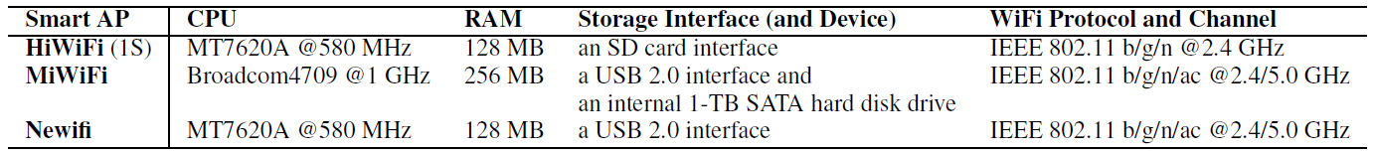
Smart APs
≈ $20
≈ $100
≈ $20
Notes:
This is the system architecture of popular smart APs.
At the heart of each smart AP is the OpenWrt OS. It is a Linux-based embedded operating system,
providing a fully writable filesystem and allowing users to install any Opkg applications.
% Note that a given smart AP device may not contain all the plotted storage interfaces.

Slide 19
4
Workload
Notes:
Having understood the representative systems, now let’s examine their workload characteristics.

Slide 20
Xuanfeng Dataset
Complete running logs during a whole week in 2015, involving 4M tasks, 0.78M users & 0.56M unique files
User Requests
User ID
IP address
Pre-downloading Trace
Start time
Finish time
Fetching Trace
User ID
Finish/pause time
Access bandwidth
Request time
File type
File size
Original data source
Transfer protocol
Acquired file size
Traffic usage
Cloud cache hit
Avg. speed
Peak speed
Success or failure
IP address
Access bandwidth
Start time
Acquired file size
Traffic usage
Avg. speed
Peak speed
Notes:
The workload is collected from Xuanfeng, that is, the complete ..., involving millions of tasks, users, and files.
Corresponding to the three phases of offline downloading, the workload is made up of three traces, and each trace includes a number of detailed attributes.

Slide 21
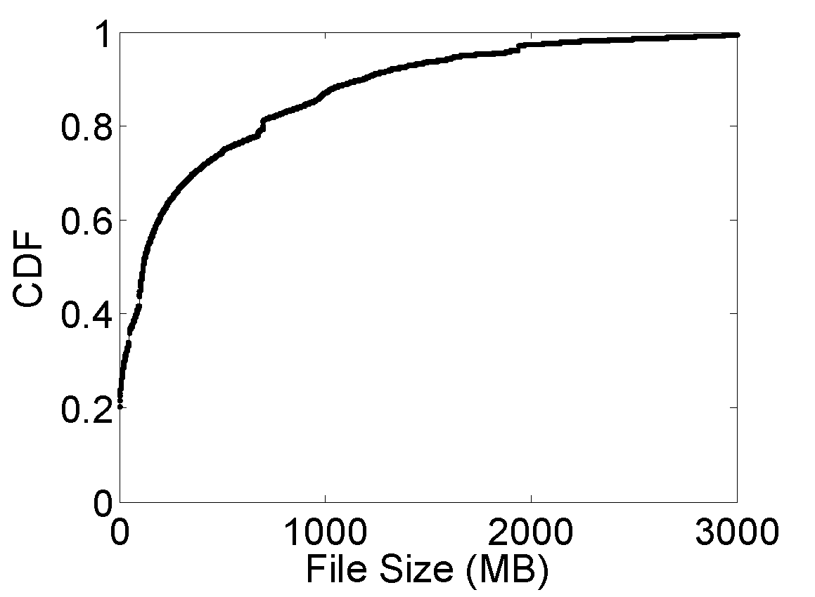
File Type, Size & Transfer Protocol
Median: 115 MB
Average: 350 MB
Maximum: 4 GB
25% files < 8 MB
Notes:
By analyzing the workload, we find that the majority of offline downloading requests are issued for videos and software.
Besides, most files are hosted in P2P data swarms, especially BitTorrent and eMule.
Regarding the file size, the median value is much smaller than the average, because a quarter of files are smaller than 8 MB, although offline downloading is originally designed for large files.

Slide 22
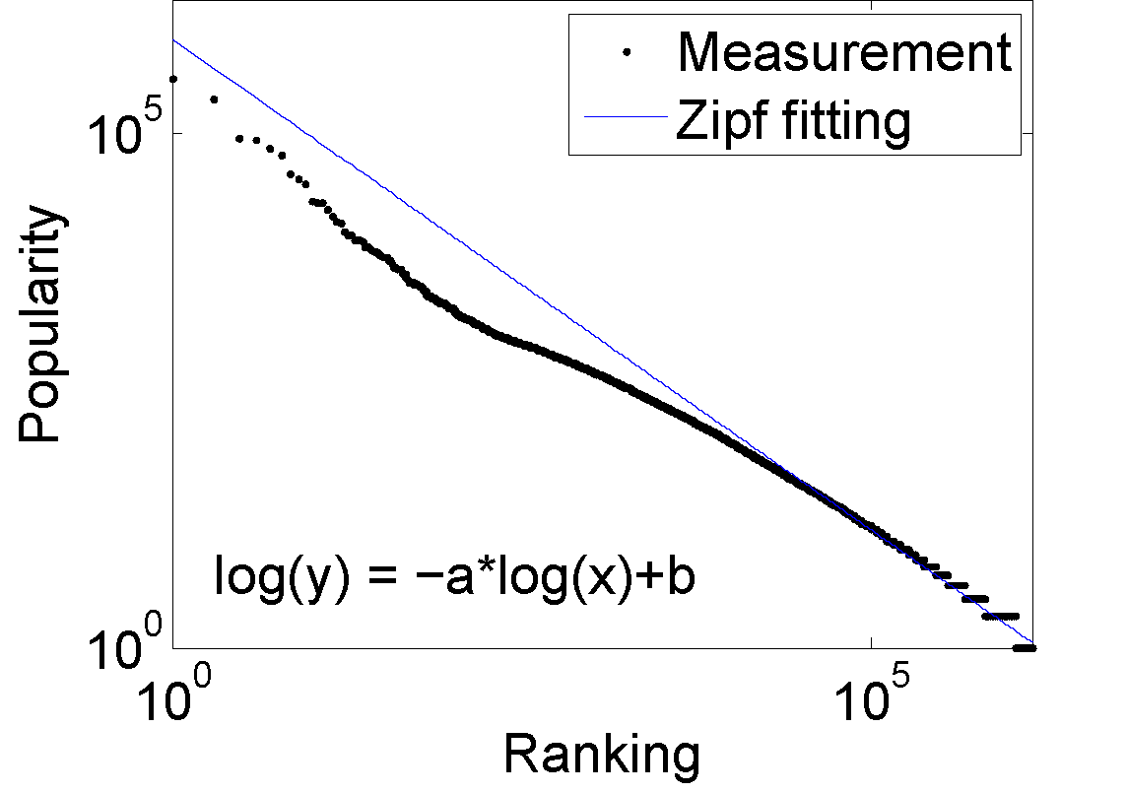
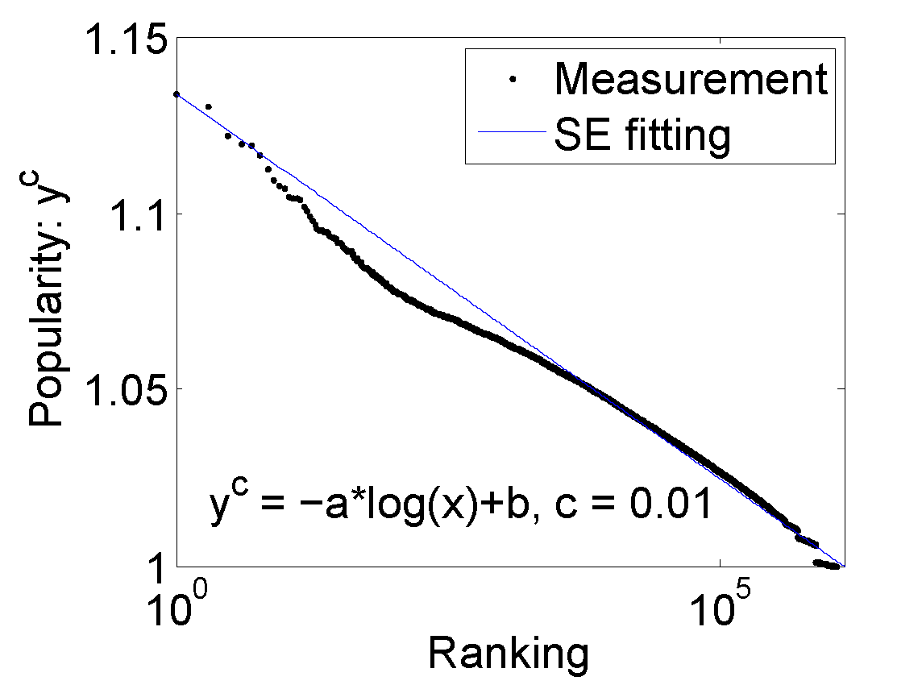
File Popularity
Zipf ≈ Power law
SE ≈ Stretched Exponential
Matthew effect (for non-videos) +
Fetch-at-most-once effect (for videos)
Notes:
The popularity of file downloading is usually considered to follow the Zipf distribution.
But for offline downloading, the stretched exponential distribution seems a better fit,
because it is a combination of the … and ....

Slide 23
Smart APs: Benchmark
*Note: We assume that the smart AP based offline downloading systems have similar workload characteristics to Xuanfeng, since most end users are not familiar with the technical details and cannot differentiate these services.
Notes:
For smart APs, we randomly pick a sampled workload from the Xuanfeng dataset to drive the benchmark experiments.

Slide 24
5
Performance
Notes:
Under the abovementioned workloads, what about the performance of offline downloading?

Slide 25
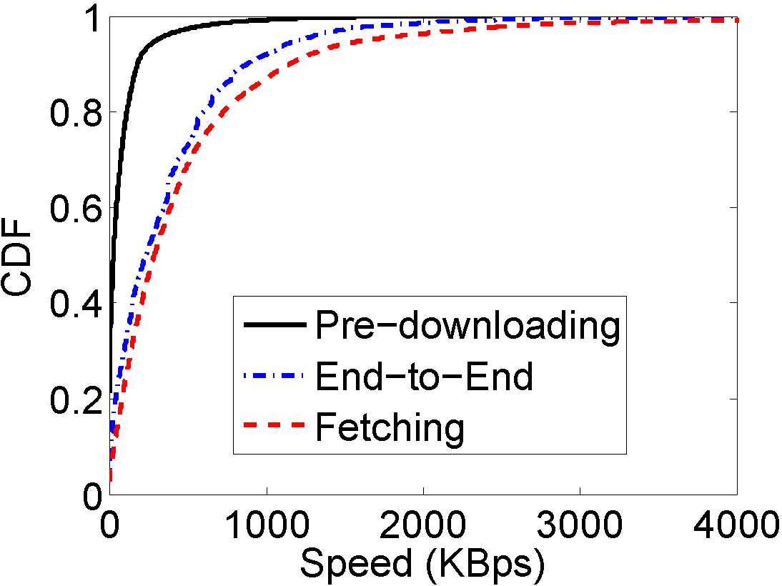

Xuanfeng: Pre-downloading Speed
and Fetching Speed
Median: 25 KBps
Average: 69 KBps
Median: 287 KBps
Average: 504 KBps
Owing to the privileged network path, Xuanfeng significantly improves users’ perceived downloading speeds by 7 – 11 times (fetching speed / pre-downloading speed)
Notes:
Our 1st finding is about the pre-downloading speed and fetching speed of Xuanfeng.
In this figure, the average pre-downloading speed is just 69 KBps, but the average fetching speed is higher than 500 KBps.
Obviously, owing to …, Xuanfeng ...

Slide 26

Xuanfeng: Unsatisfactory Fetching Speed
1
28% of fetching speeds are below 125 KBps (= 1 Mbps, typical playback bitrate of HD videos)
☜
9.6%
ISP barrier
10.8%
Low user-side access bandwidth
1.5%
Lack of cloud-side upload bandwidth
6.1%
Unknown...
The cloud-based approach performs poorly once there is a bandwidth bottleneck in the privileged network path between the cloud and the user
Notes:
Nevertheless, the user’s fetching speed is still unsatisfactory. 28% ...
This is the 1st performance bottleneck of offline downloading.
In detail, low fetching speeds are mainly caused by IPS barrier and low user-side access bandwidth, as well as the lack of ...
In a nutshell, the cloud-based approach ..

Slide 27
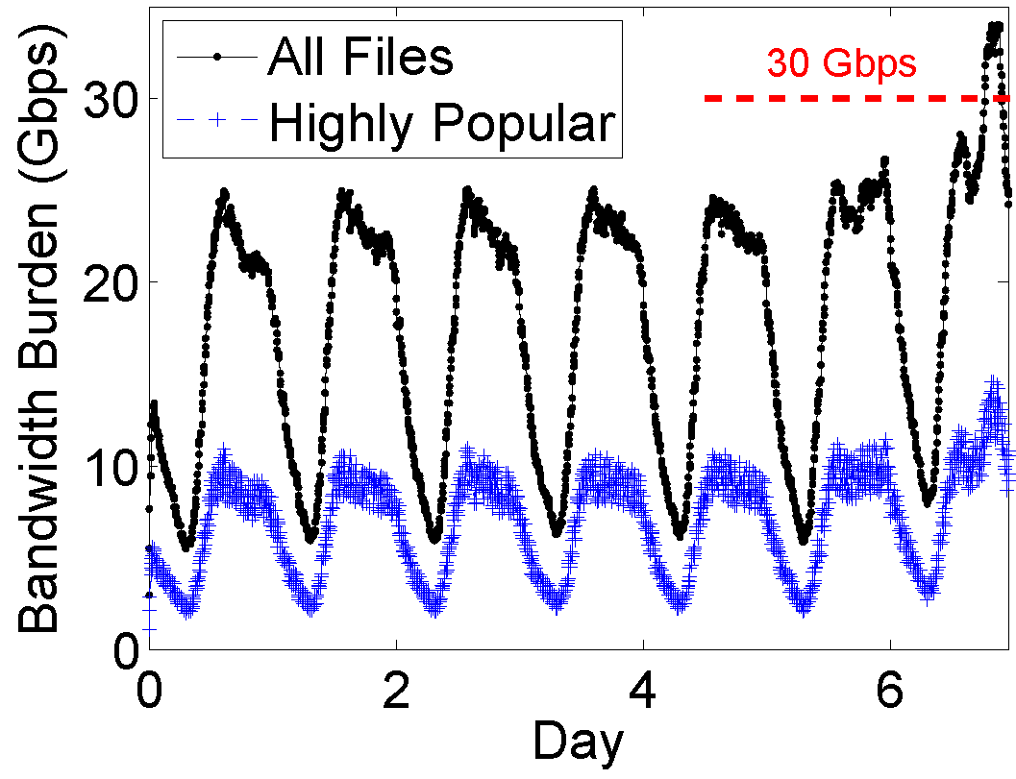

Xuanfeng: Shortage of Cloud Bandwidth
☜
1.5%
Lack of cloud-side upload bandwidth
0.84% of highly popular files account for 39% of all downloads
87% of requested files are hosted in peer-to-peer (P2P) data swarms
2
The cloud is threatened by running out of upload bandwidth due to unnecessarily sending highly popular P2P files. As the user base continues to grow, the cloud will have to reject more (>1.5%) fetching requests.
Notes:
Our 2nd finding is about the shortage of cloud bandwidth, that is, 1.5% fetching requests are rejected by the cloud for a lack of cloud-side upload bandwidth.
Remembering that 0.84% … and 87% …, we conclude that …
This is the 2nd performance bottleneck of offline downloading.

Slide 28
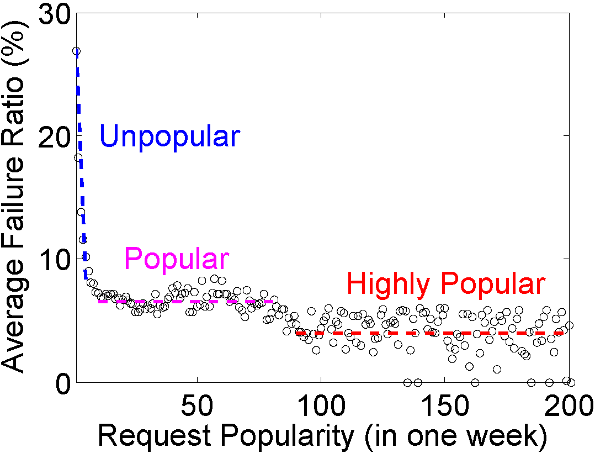
Xuanfeng: Pre-downloading Failure
2-PB Collaborative Caching → 8.7% Failure
X
→ 16.4% Failure
The cloud cache effectively avoids nearly half of pre-downloading failures
High popularity ≈
Low failure ratio
Notes:
Our 3rd finding is about the pre-downloading failure.
The 2-PB collaborative cache makes the pre-downloading failure ratio of Xuanfeng as low as 8.7%.
In comparison, if we remove the cloud cache, the failure ratio will almost double.
For a certain file, high popularity generally implies low failure ratio, while ...

Slide 29
Smart APs: Pre-downloading Failure
86% Insufficient seeds in a peer swarm
Failure Ratio | Xuanfeng Cloud | Smart APs
Overall | 8.7% | 16.8%
Unpopular files | 13% | 42%
10% Poor HTTP/FTP connections
4% Unknown...
36% of offline downloading requests are issued for unpopular files
3
Smart APs frequently fail during pre-downloading unpopular files
Notes:
For a lack of collaborative cache, the pre-downloading failure ratio of smart APs is much higher than the Xuanfeng cloud.
In particular, nearly half of unpopular files cannot be successfully pre-downloaded.
No that 36% …
So we get the 3rd performance bottleneck of offline downloading, that is , ...

Slide 30
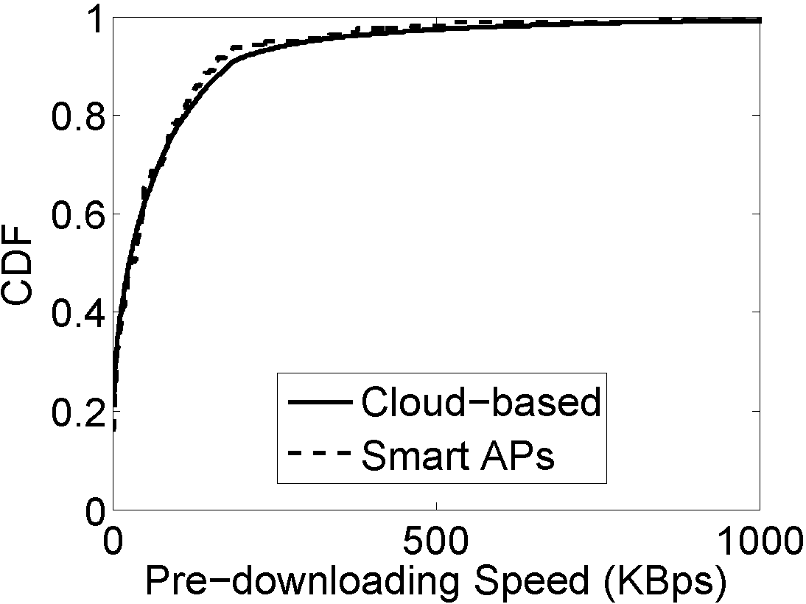

Smart APs: Pre-downloading Speed
Speed | Xuanfeng Cloud | Smart APs
Median | 25 KBps | 27 KBps
Average | 69 KBps | 64 KBps
<
>
?
A smart AP’s pre-downloading speed can be restricted by its hardware and/or filesystem, since some types of storage devices and filesystems do not fit the pattern of frequent, small data writes during pre-downloading
4
Notes:
Our 4th finding is about the pre-downloading speed of smart APs.
Interestingly, the median speed of Xuanfeng is lower than that of smart APs, while the average speed of Xuanfeng is higher.
To demystify this counter-intuitive phenomenon, we carefully examine the performance data of every task in the sampled workload.
Surprisingly, we uncover the 4th performance bottleneck of offline downloading: …

Slide 31
Smart APs: Pre-downloading Speed
NTFS is incompatible with the OpenWrt OS
USB flash drive is unsuitable for frequent, small data writes
Notes:
More in detail, among all the storage devices, USB flash drive is the slowest since it is unsuitable ...
This is also reflected by the corresponding high iowait ratios.
In addition, among all the filesystems, NTFS is the worst because it is incompatible with the OpenWrt OS.

Slide 32
Performance Summary
Xuanfeng Cloud | Smart APs
Bottleneck 1: Unsatisfactory fetching speed | Merit 3: Stably high fetching speed
Bottleneck 2: Shortage of cloud bandwidth | Merit 4: No cloud infrastructure
Merit 1: Effective avoidance of pre-downloading failures | Bottleneck 3: Frequent failures during pre-downloading
Merit 2: No hardware cost at the user side | Bottleneck 4: Hardware/filesystem restrictions on pre-downloading
The two approaches are subject to distinct performance bottlenecks ☹
while also being complementary to each other ☺
Notes:
By summarizing all the performance merits and bottlenecks in a table, we can clearly notice that ...

Slide 33
6
Optimization
Notes:
Guided by the above findings, we are able to optimize the performance of offline downloading.

Slide 34
ODR Middleware
Help users automatically select a proper (offline) downloading way
Primary goal: minimizing the downloading time and failure ratio
Secondary goal: minimizing the upload bandwidth burden on the cloud
Notes:
Our method is to develop the Offline Downloading Redirector middleware to help ...
Our primary goal is ...

Slide 35
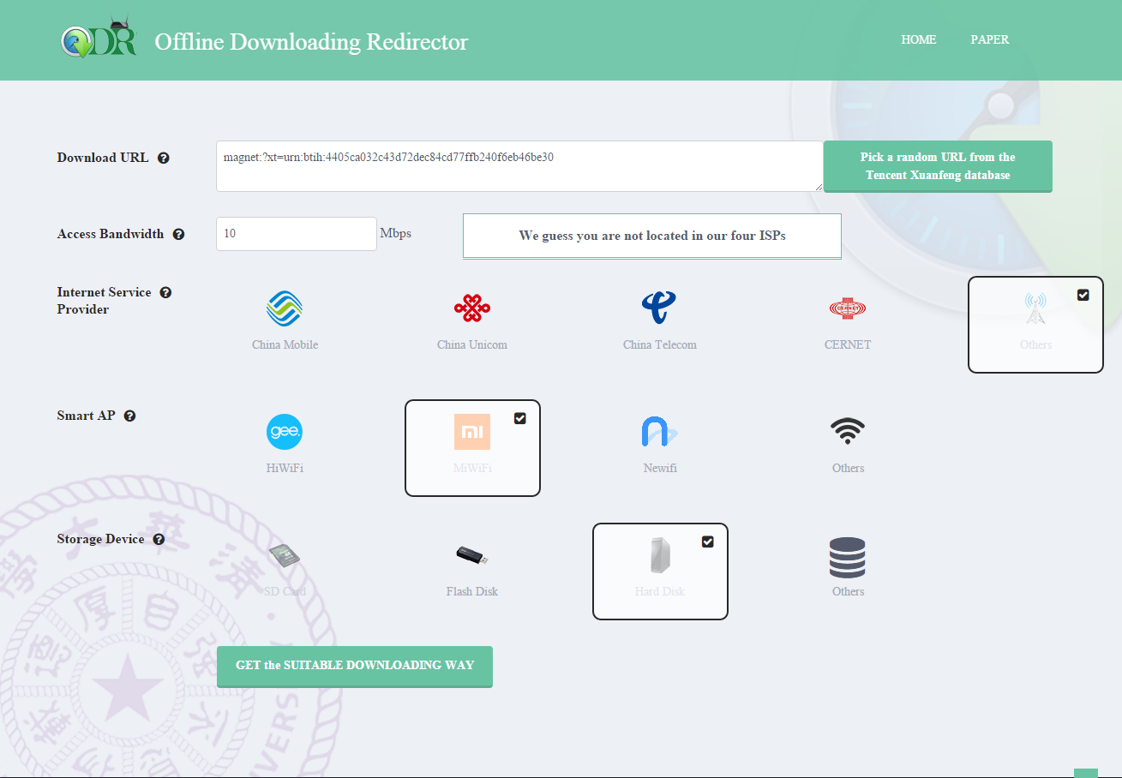
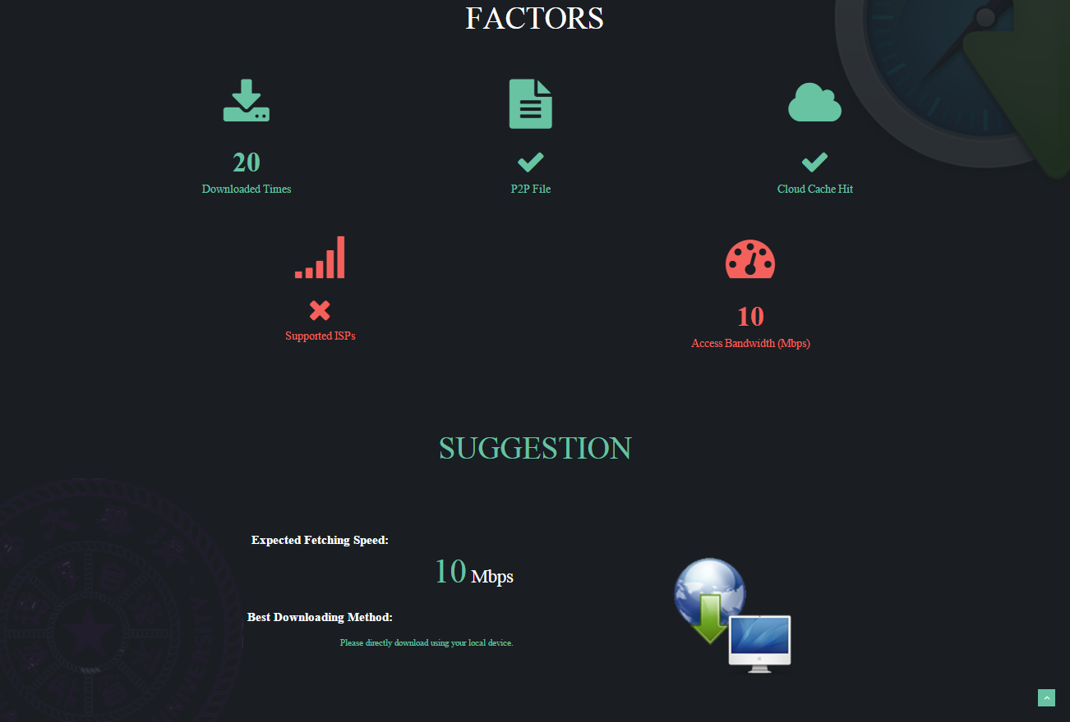
ODR Web Site
http://odr.thucloud.com
Notes:
ODR is presented as a public web service to users available at this link.
First, the user needs to input the download URL and the access bandwidth.
Then, ODR will report the impact factors, and suggest the expected fetching speed and best downloading method.

Slide 36
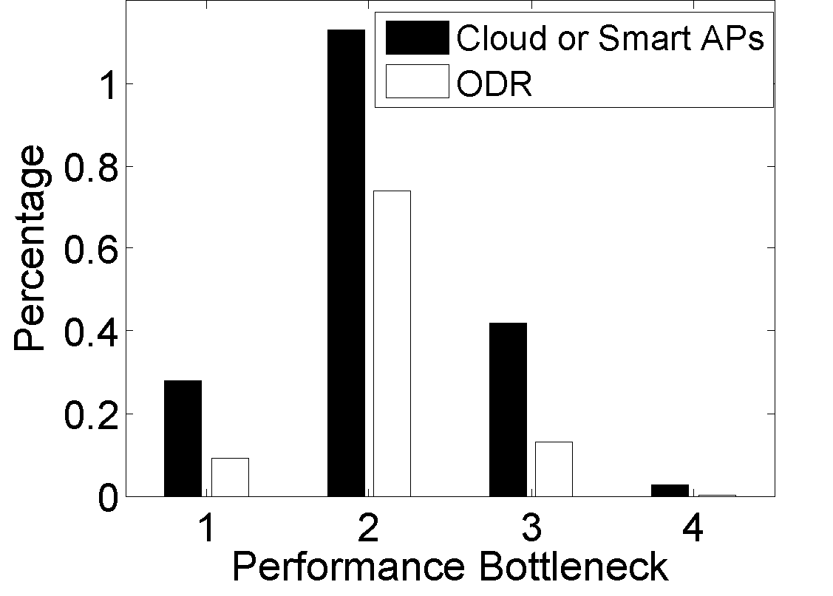
ODR Design & Performance
Heuristic rules extracted from measurement findings
Even using this coarse-grained design, we manage to remarkably reduce the current performance bottlenecks of offline downloading !
Notes:
At the moment, we have designed and implemented ODR based on a series of heuristic rules extracted from our measurement findings.
We are glad to observe that Even …

Slide 37
Summary
What Offline Downloading is and Why it is popular in China
Selection Dilemma of Offline Downloading
Measurement findings of Xuanfeng and popular smart APs
◆The two approaches are subject to distinct performance bottlenecks, while also being complementary to each other.
We feel that offline downloading has broad applicability to other areas of the world that lack broadband penetration. By deploying offline downloading technologies, coupled with our proposed ODR middleware, the Internet experiences for users in many parts of the world can be improved.
Notes:
In summary, our work introduces ...
We point out … and present … In particular, we find that …
Thus, we develop …
Finally,

Slide 38

Thank you! Any questions?
Xuanfeng is pronounced as
[ʃuæn fəŋ] or simply XF
HiWiFi
Xunlei is pronounced as
[ʃunlei] or simply XL
MiWiFi
Baidu
CloudDisk
Newifi
Notes:
In summary, our work introduces ...
We point out … and present … In particular, we find that …
Thus, we develop …
Thank you for your attention!

Slide 39
Backup slides

Slide 40
Xunlei, Xuanfeng, and Baidu CloudDisk
Xunlei
Launched in 2009
Over 80M users
Tencent
Xuanfeng
Launched in 2010
Over 30M users
Baidu
CloudDisk
Launched in 2012
Over 150M users

Slide 41
Xunlei, Xuanfeng, and Baidu CloudDisk
Xunlei
Charges each user nearly $2 per month
Over 80M users
Tencent
Xuanfeng
Conditionally free --- should be the VIP user of Tencent
Over 30M users
Baidu
CloudDisk
Totally free --- the user even does not need to register
Over 150M users

Slide 42
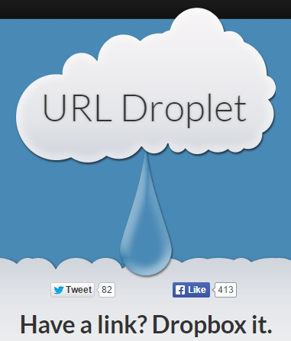
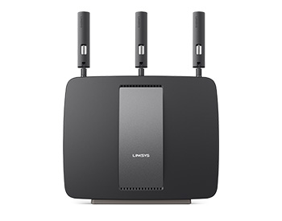
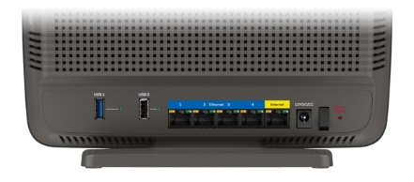
Offline Downloading outside China
Besides those developing countries, developed countries can also benefit from offline downloading (based) services.
SMART WI-FI ROUTERS
USB storage interface

Slide 43
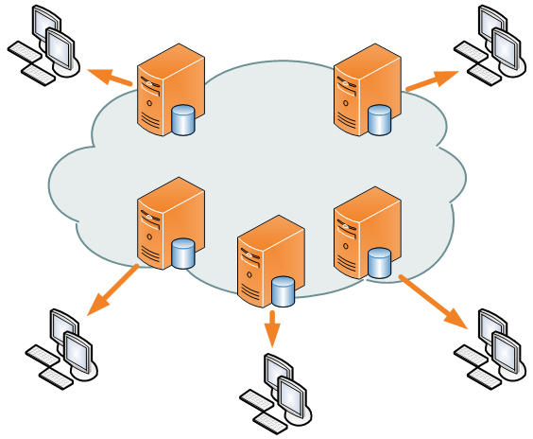

State-of-Art Downloading Techniques
CDN typically only help to deliver files for content providers who pay for the service.
The business model of offline downloading is the opposite of CDN, because it charges (or sometimes frees) its users, i.e., content receivers, for better downloading experiences.
Offline Downloading ≈
DTN + reverse-CDN
ICN
CCN
NDN
1) in-network storage for caching
2) decoupling content senders and receivers
3) disruption tolerance
4) multi-party communication through replication
5) mobility and multi-homing

Slide 44
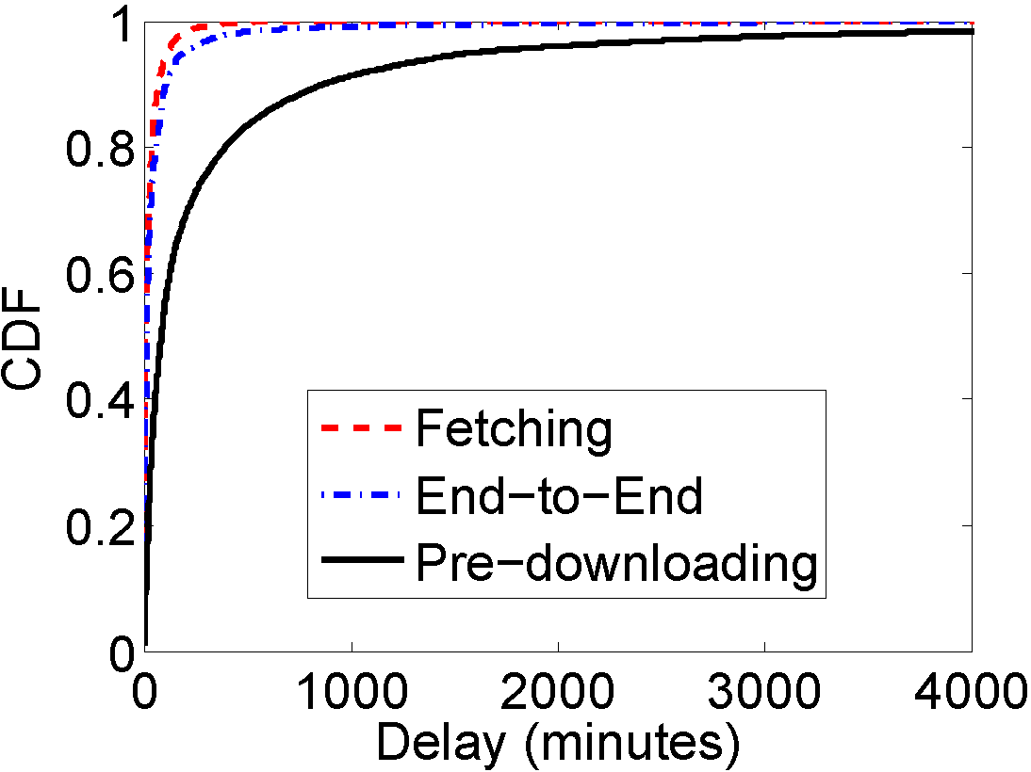
Performance: Delay
Median: 7 minutes
Average: 27 minutes
Median: 82 minutes
Average: 370 minutes
Xuanfeng reduces users’ perceived downloading delay by 12 – 14 times

Slide 45
Performance: End-to-End
Median: 233 KBps
Average: 380 KBps
The collaborative cache of Xuanfeng remarkably avoids 89% pre-downloads
Median: 10 minutes
Average: 68 minutes

